Slide 1
SimpylCellCounter Protocol
Aneesh Bal
Python Initiation
Download Anaconda (1)
Create Virtual Environment (2)
Install Jupyter Notebook (3)
Package Installation
Install Required Packages (4)
Adjust Directories
Arrange Images (5)
Run SimpylCellCounter
Open Jupyter Notebook (6)
Set Paths (7)
Run Code (8)
Find Output (9)

Slide 2
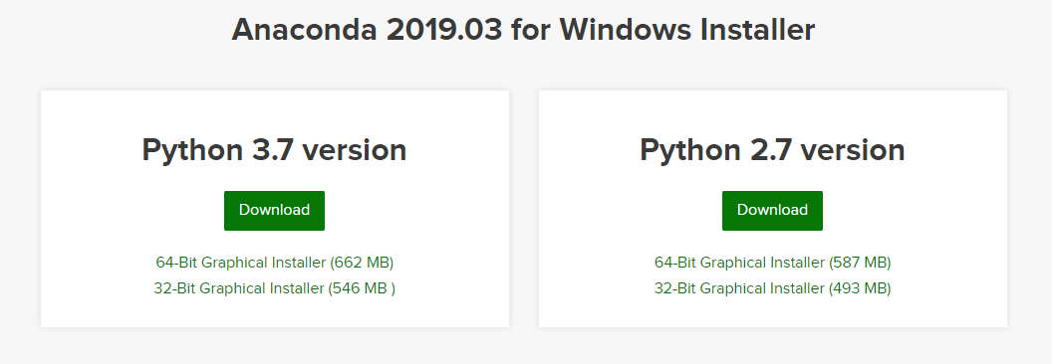
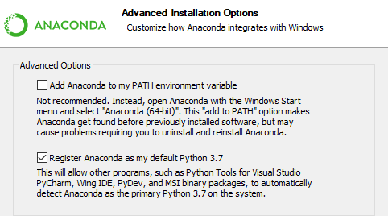
Python Initiation – Download Anaconda (1)
Download Python with Anaconda
Visit https://www.anaconda.com/distribution/
Find “Windows” installation option
Click “Download” on “Python 3.7 Version” as shown in the image
Run the downloaded application
Anaconda Set-Up
Inside Installation Wizard
Do NOT select “Add Anaconda to PATH environment variable”
Select “Register Anaconda as my default Python 3.7” and Install
Once installed, select Finish
Anaconda and Python are now installed successfully on the computer! Next we must create a virtual environment…

Slide 3
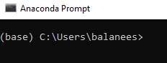
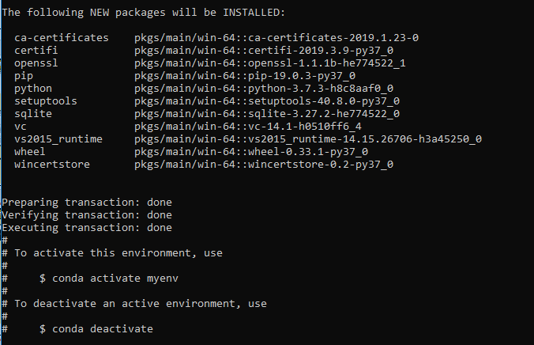
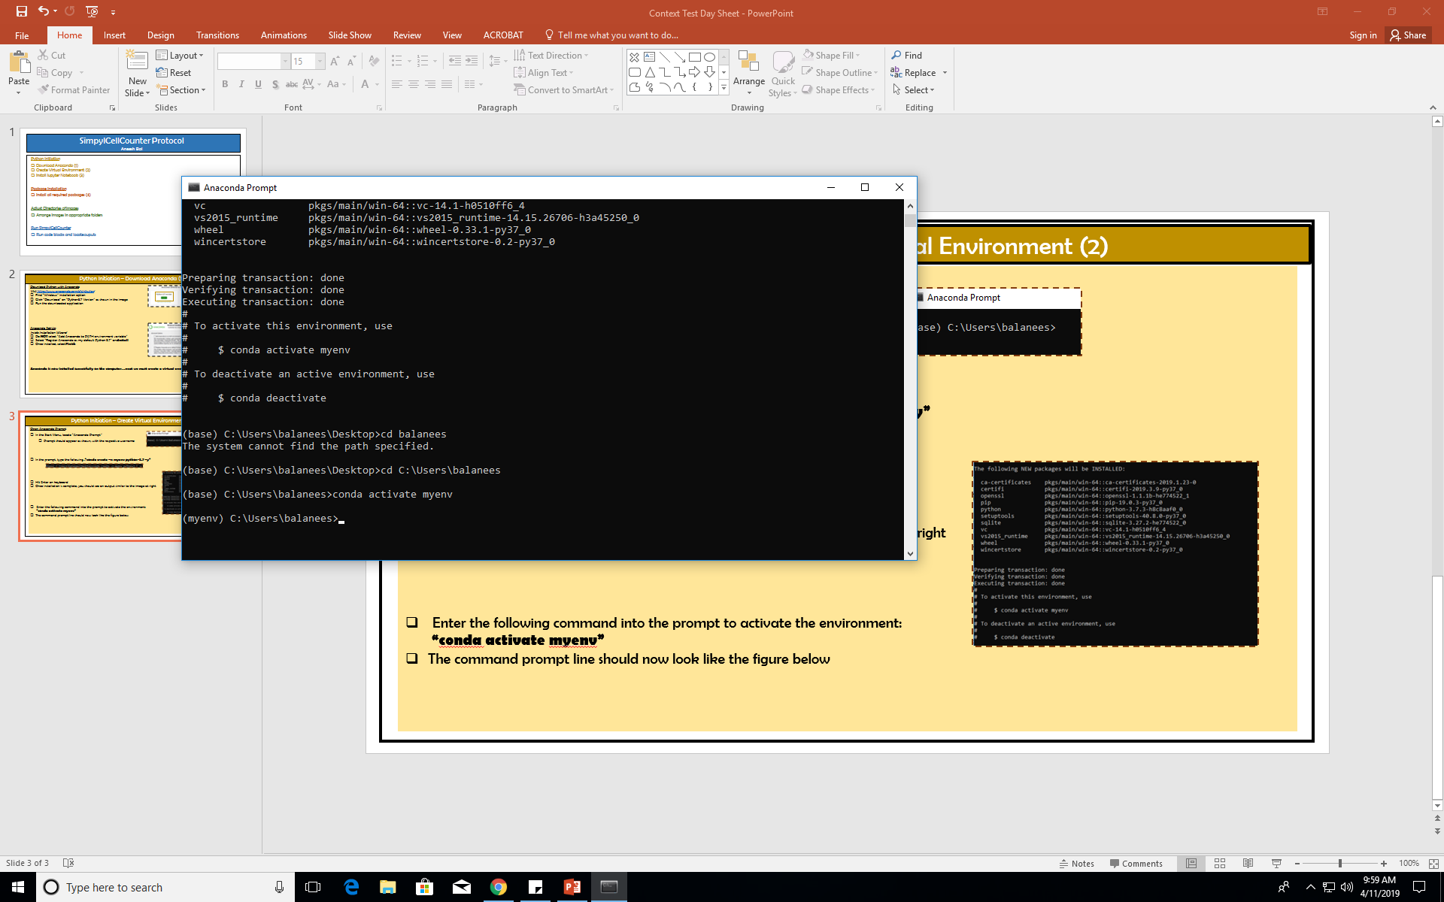
Python Initiation – Create Virtual Environment (2)
Open Anaconda Prompt
In the Start Menu, locate “Anaconda Prompt”
  Prompt should appear as shown, with the respective username
In the prompt, type the following...“conda create –n myenv python=3.7 –y”
Hit Enter on keyboard
Once installation is complete, you should see an output similar to the image at right
Enter the following command into the prompt to activate the environment:
“conda activate myenv” and hit Enter on keyboard
The command prompt line should now look like the figure below
Your virtual environment is now activated! Now we must install Jupyter Notebook…

Slide 4
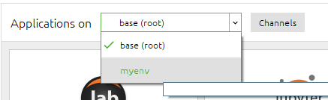
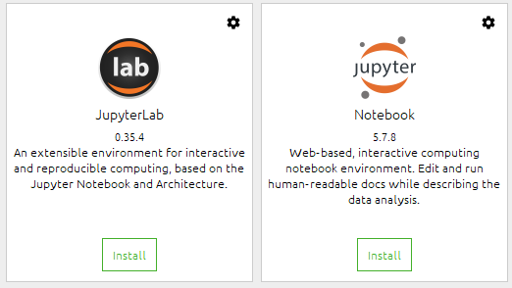
Python Initiation – Install Jupyter Notebook (3)
Open Anaconda Navigator
In the Start Menu, locate “Anaconda Navigator”
Select this and wait for it to initialize
Once open, find “Applications on” dropdown menu, and select “myenv”
On the applications “Jupyter Lab” and “Notebook”, select Install
Exit the navigator
Go back to Anaconda Prompt
In the prompt, type in “jupyter notebook” (case-sensitive!!)
Select option to open in “Google Chrome”
Jupyter notebook should now be open in a Chrome tab
We have successfully opened Jupyter notebook! Now it is time to install our packages…

Slide 5
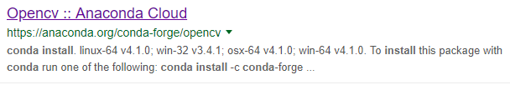
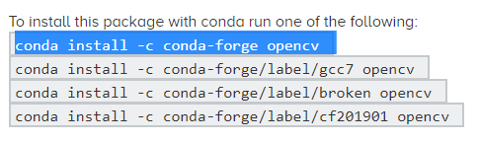
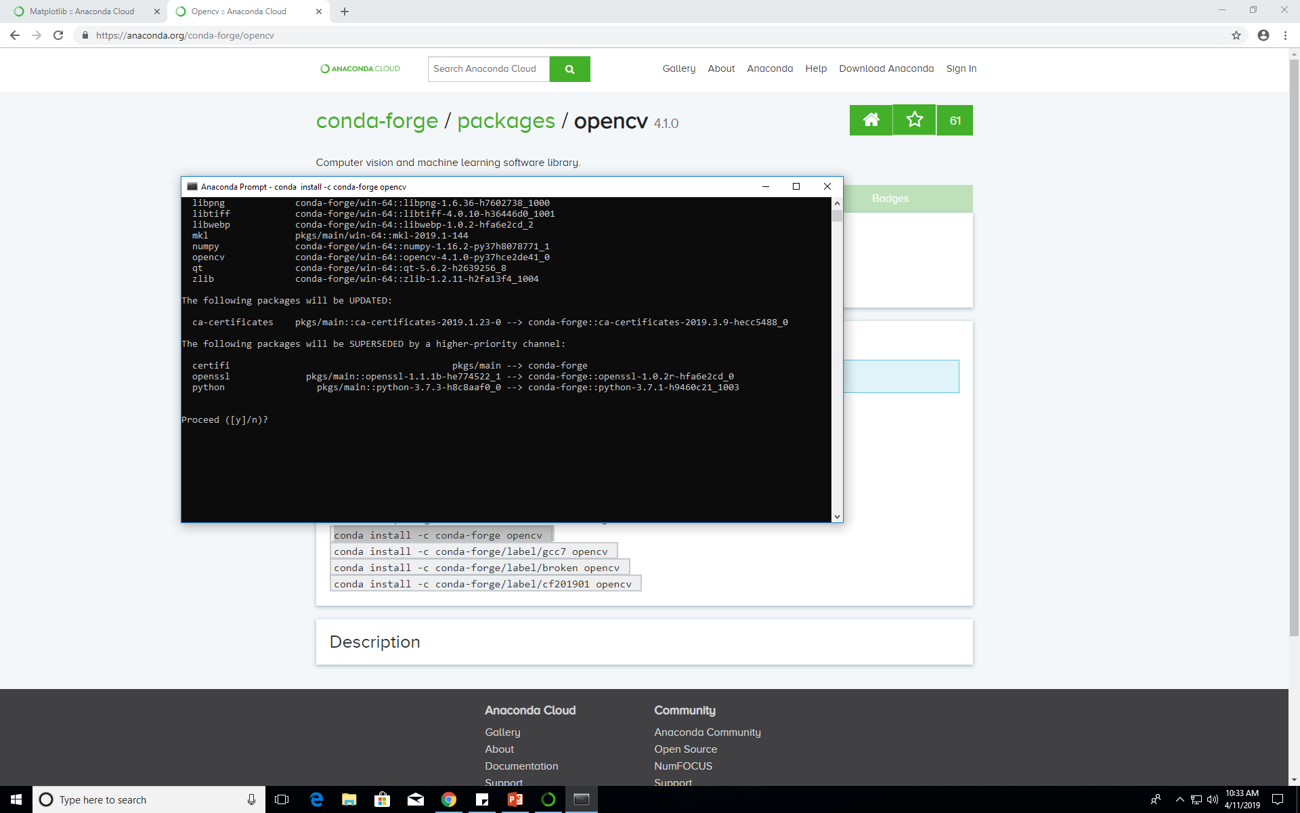
Package Installation – Install Required Packages (4)
Open New Anaconda Prompt
Open a new Anaconda Prompt, same way as shown earlier, and activate our virtual environment (“conda activate myenv” in prompt)
Once inside virtual environment, we will need to install the following ESSENTIAL packages
  openCV, numPy, os, sys, pandas
To install packages, a general rule exists…Google it! Here, I will show installation of “openCV” package
Google “conda install (name of package)”… in this case “conda install openCV”
To install package, simply copy-paste text provided on the website into Anaconda Prompt inside your virtual environment and hit Enter
When asked to proceed, type “y” and hit Enter
We have now successfully installed openCV! To install other packages, simply Google “conda install (package name)”, and follow same steps. To see a similar walk-through of installing the remaining packages, refer to the end of this protocol…

Slide 6
Adjust Directories – Arrange Images (5)
Open Directories with Images
Directories is just a fancy name for folders!
Structure the directories as shown
Now that we have our images arranged, we can run the code!
We need to open Jupyter Notebook again…
Main Folder
2nd
Animal 1
Animal 2
Image
Image

Slide 7
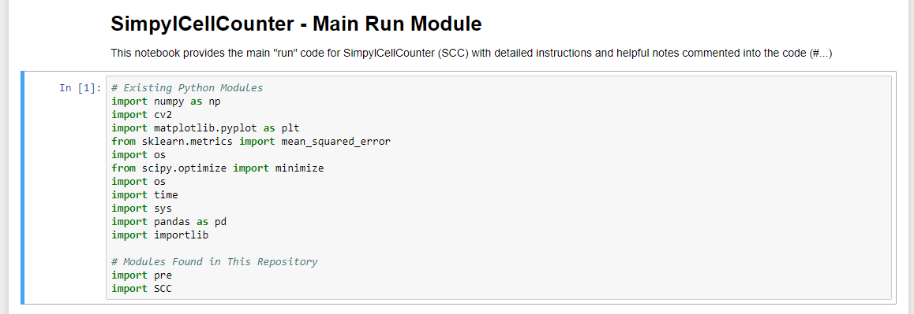
Run SimpylCellCounter – Open Jupyter Notebook (6)
Open Virtual Environment
Open Anaconda Prompt and type “conda activate myenv”
Once inside virtual environment, in the prompt line type “jupyter notebook”
Now that Jupyter Notebook is open, find file called “Test SCC.ipynb”
Open file within Jupyter Notebook…SimpylCellCounter code should appear similar to the image
Highlight first code block by clicking inside it
Press Shift+Enter to execute code block
Executing the first code block imports all the packages required for the algorithm
This block may take some time to execute since it is the first code block
Now that we have executed the first code block and imported all of our packages, it is time to set the PATH…

Slide 8
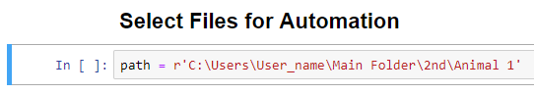
Run SimpylCellCounter – Set Paths (7)
Once you are Inside SimpylCellCounter Code
Find code block labeled “Select Files for Automation” and highlight this block
For variable “path”, type in path for folder where one set of images is located, as shown in figure
For variable “save_path”, type in the path for a folder where you would like to .csv file with the final counts (output file)
Main Folder
2nd
Animal 1
Animal 2
Image
Image

Slide 9
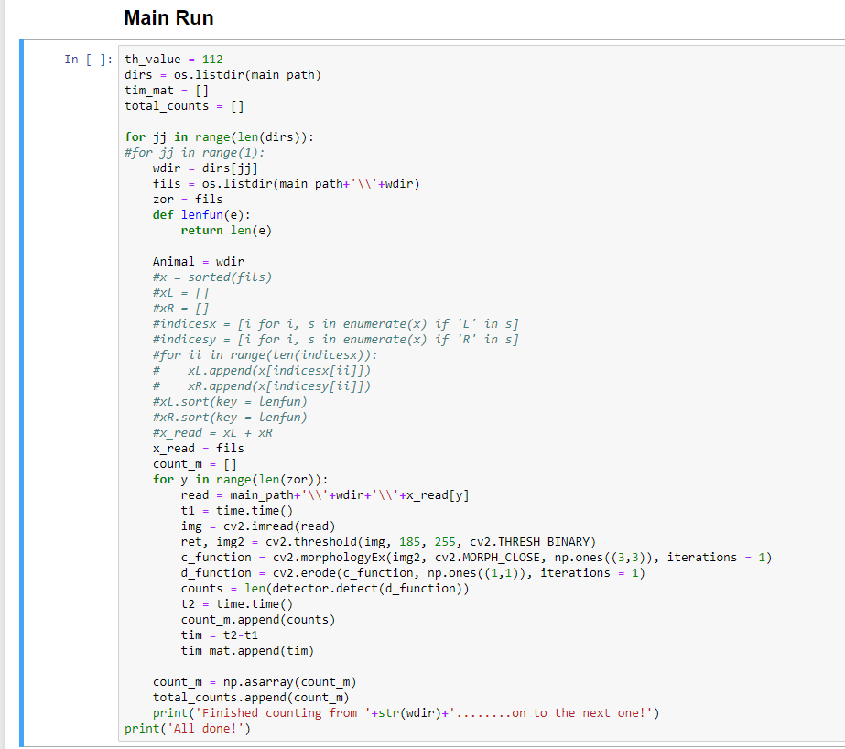
Run SimpylCellCounter – Run Code (8)
Once PATH is Set
Find code block labeled “Main Run”
For variable “th_value”, enter in threshold value
Run code block by clicking Shift+Enter

Slide 10
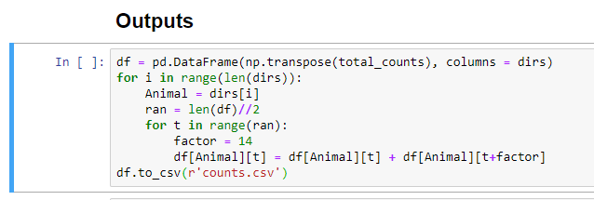
Run SimpylCellCounter – Find Output (9)
Once “Main Run” is Executed
Find code block labeled “Output”
Run code block by clicking Shift+Enter
A CSV file with cell counts should now be located in the folder that was designated…
That’s all!

